Slide 1
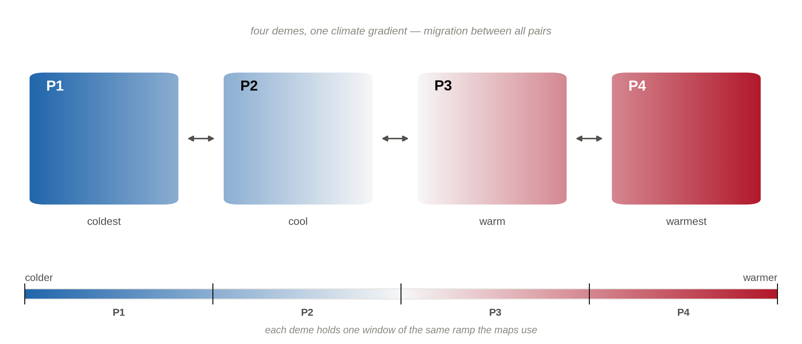
Four demes along one climate gradient

